Slide 1
Intelligent Q&A System with Generative AI for DPM , DFPDS & GPR Documents
( Industry Project )
Department : AI & DS
Vishwakarma Institute Of Information Technology - Pune

Slide 2
Team :
Students:
Omkar Khade
Urvi Shah
Suyash Yeolekar
Vaidehi Mahale
Faculty Coordinator:
Asst. Prof. Suvarna Bhagwat

Slide 3
Brief Overview :
Our primary goal is to leverage Generative AI technologies to create a robust chatbot capable of providing intelligent responses based on DPM , DFPDS & GFR Documents.
Throughout this project, we've utilized cutting-edge technologies such as Retrieval Argument Generation (RAG), frameworks like Haystack and Langchain, and incorporated state-of-the-art language models.
Objective: To develop an intelligent Q&A system/Chatbot using Generative AI technologies.
Data source : DPM , DFPDS & GFR Documents in PDF form
Technologies Used Till Now : RAG (Retrieval-augmented generation), Haystack, Langchain, Vector Store, Embedding Model, LLM models (Flan, T5, BERT, Roberta, Bart, Llama 2, Mistral Ai).

Slide 4
Retrieval Argument Generation (RAG) Approach :
Meta AI researchers introduced a method called Retrieval Augmented Generation (RAG) to address such knowledge intensive tasks. RAG combines an information retrieval component with a text generator model.
RAG is seamlessly integrated into our Q&A system, serving as a fundamental component for argument generation.
We have used Langchain and Haystack Frameworks to implement this approach.
Technology stack in brief :
Frontend: Gradio / Streamlit LLM Models : HuggingFace, Transformers, (LLAMA2)
Backend : I. Programing Language : Python
II.Frameworks/Libraries : pytorch, FAISS , LangChain , PDF Reader, accelerate, bitsandbytes, Sentence-Transformers.

Slide 5
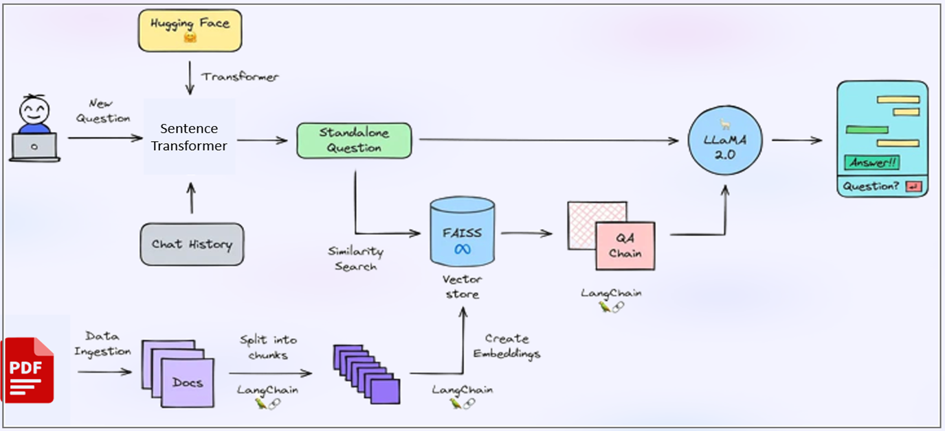
System Architecture

Slide 6
Fine Tunning Approach : (Future Work)
Custom Dataset Creation: we are building custom dataset to finetune LLM model based on DPM, DFPDS, and GFR documents.
Fine-Tuning Llama 2: LLama 2 is one the best open source llm model available today that why, Planning to fine-tune the state-of-the-art LLM model, Llama 2.
Qlora Technique Implementation: Qlora, an advanced fine-tuning method, allows for a more targeted adaptation of the LLMs to our specific use case
Quantization for Low Memory Usage: Exploring the quantization technique to optimize memory usage. By quantizing the LLM model, we aim to reduce its memory footprint, making it more efficient for deployment in environments with lower memory resources

Slide 7
Thank You

